Slide 1
Flexible working
January 2024

Slide 2
Agenda
Legal framework
Changes to the statutory scheme
Dealing with requests

Slide 3
Legal framework
Section 80F of the Employment Rights Act 1996
ACAS Code of Practice on flexible working requests – statutory code
Updated version due to be published in 2024

Slide 4
Updates to flexible working requests
Day one right
Employee can make two statutory requests in any 12-month period
Must make decision within 2 months
If rejecting, employer must consult on alternative arrangements
No requirement for the
to outline how the change would affect their employer and how they could deal with it

Slide 5
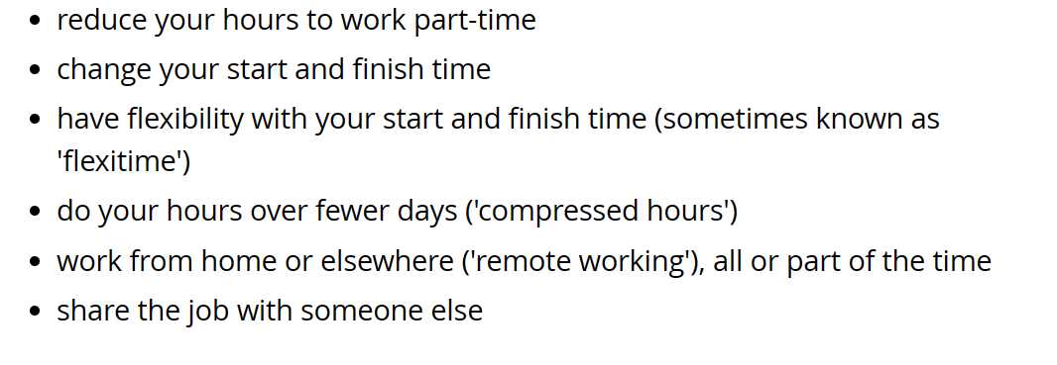
Flexible working request
No reason required

Slide 6
The process
Employee must put their flexible working request in writing:
Date of application; change they’re seeking; when it should come into effect
Clearly state it’s a request under the statutory scheme and where they have made a request previously
A meeting with RTBA should be scheduled to discuss the request
Consider the request and deliver outcome in writing
Check if you have an internal policy

Slide 7
Flexible working request outcome
Trial periods; permanent change?
Rejecting on 8 statutory business grounds:
The burden of additional costs
Detrimental effect on ability to meet customer demand
Inability to reorganise work among existing staff
Inability to recruit additional staff
Detrimental impact on performance
Insufficiency of work during the periods the employee proposes to work
Planned structural changes

Slide 8
Next steps
Familiarise yourself with internal policy
Make changes to your policy before 6 April 2024
Communicate update in policy and legislation to employees
Train HR staff/ any personnel using the policy
Evaluate current practices – particularly timescales

